Slide 1


MBTA 2025
COURSE: CS506
FINAL REPORT
Data Science Tools and Applications
Spring 2025
Boston Bus
Equity Analysis
Evaluating Transit Performance & Neighborhood Impact
CLIENT
PREPARED BY
City of Boston Analytics Team
zztangbu@bu.edu • lzj2729@bu.edu
In Collaboration with Spark!
ljf628@bu.edu • yaobc@bu.edu
BOSTON UNIVERSITY
FEBRUARY 2025

Slide 2













Project Overview and Research Goals
This study examines ridership trends, delay patterns, and service disparities across Boston neighborhoods to assess the impact of bus performance on diverse demographic groups.
Key Research Questions
Core Goal
To better understand the impact of bus performance on Boston residents by examining service performance trends through the dual lens of geography and demographics.
RIDERSHIP TRENDS
OPERATIONAL EFFICIENCY
How has ridership changed from pre-pandemic to post-pandemic across various routes?
What are the citywide average delays, wait times, and end-to-end travel times?
TARGET ROUTES
SERVICE DISPARITIES
How do the "Target Routes" (equity-priority) perform compared to the rest of the network?
Are there significant variations and clusters in service quality between different routes?
Project Scope
EQUITY & DEMOGRAPHICS
Temporal: Pre-pandemic (2016) to Current (2024)
Do service quality and performance metrics vary based on neighborhood minority population, poverty rates, or income levels?
Spatial: 22 Boston neighborhoods and 2,910 bus stops.
Data Scale: Analysis of ~27M arrival records and ~1.8M ridership records.
Note: This analysis utilizes MBTA Open Data Portal and Census/ACS Demographics from the Boston Planning & Development Agency.

Slide 3
















DATA SOURCES & METHODOLOGY
Integrating MBTA operational data with socio-economic indicators.
PRIMARY DATA ASSETS
PROCESSING PIPELINE
Bus Arrival/Departure Times
~27M Records
01
Chunked Loading
MBTA Open Data Portal (2020-2024). Used for delay and wait time calculations.
Processing massive CSV files in 500K-row chunks for memory efficiency.
02
Bus Ridership by Trip
Delay Calculation
~1.8M Records
Parsing timestamps to compute actual - scheduled performance metrics.
MBTA Open Data Portal (2016-2024). Enables pre/post pandemic comparison.
03
Geographic Mapping
Census/ACS Demographics
Neighborhood Level
Mapping 2,910 bus stops to 22 neighborhoods using coordinate-based matching.
BPDA (2015-2019). Socio-economic profiling (Income, Poverty, Race).
04
Equity Profiling
Creating demographic profiles for 210 routes based on neighborhoods served.
DATA LIMITATION NOTE
22
210
2018-2019 Arrival data unavailable on portal; ridership analysis remains comprehensive for full 2016-2024 period.
NEIGHBORHOODS
BUS ROUTES

Slide 4



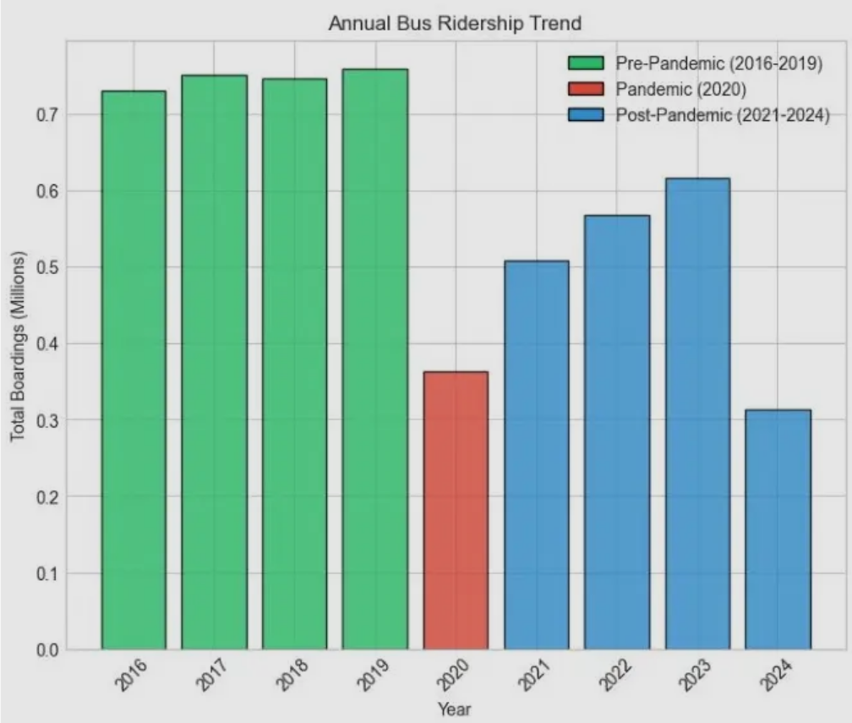






Bus Ridership Trends (2016-2024)
Ridership experienced a dramatic decline due to the pandemic. While recovery is underway, current volumes remain 32.8% below the pre-2020 average.
PRE-PANDEMIC AVG
746,761
Annual Bus Ridership Trend (Millions)
Annual Boardings (2016-2019)
PANDEMIC IMPACT
-51.3%
Sharp decline in 2020 ridership
2023 RECOVERY
616,157
Strongest post-pandemic recovery year
Pre-Pandemic
Note: 2024 data is partial (through available months), showing a projected lower total compared to the 2023 peak.
Pandemic
Post-Pandemic

Slide 5





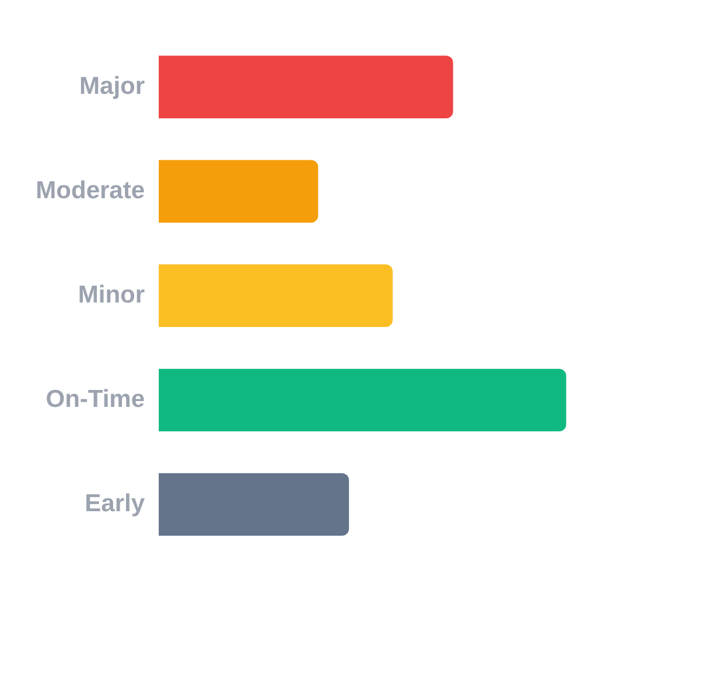












Citywide Operational Performance and Delays
Boston buses average a 7.51-minute delay with only 31.7% on-time performance.
MEAN DELAY
Delay Category Breakdown (%)
7.51 min
CRITICAL PEAK PATTERNS
Evening Rush Hour
ON-TIME PERFORMANCE
Highest delays recorded between 4:00 PM – 7:00 PM due to peak urban congestion.
31.7%
Seasonality
MEDIAN DELAY
Significant performance degradation during Winter Months (weather-related disruptions).
1.34 min
Weekend Stability
95TH PERCENTILE
Service exhibits slightly higher reliability and better on-time performance on weekends.
42.6 min

Slide 6






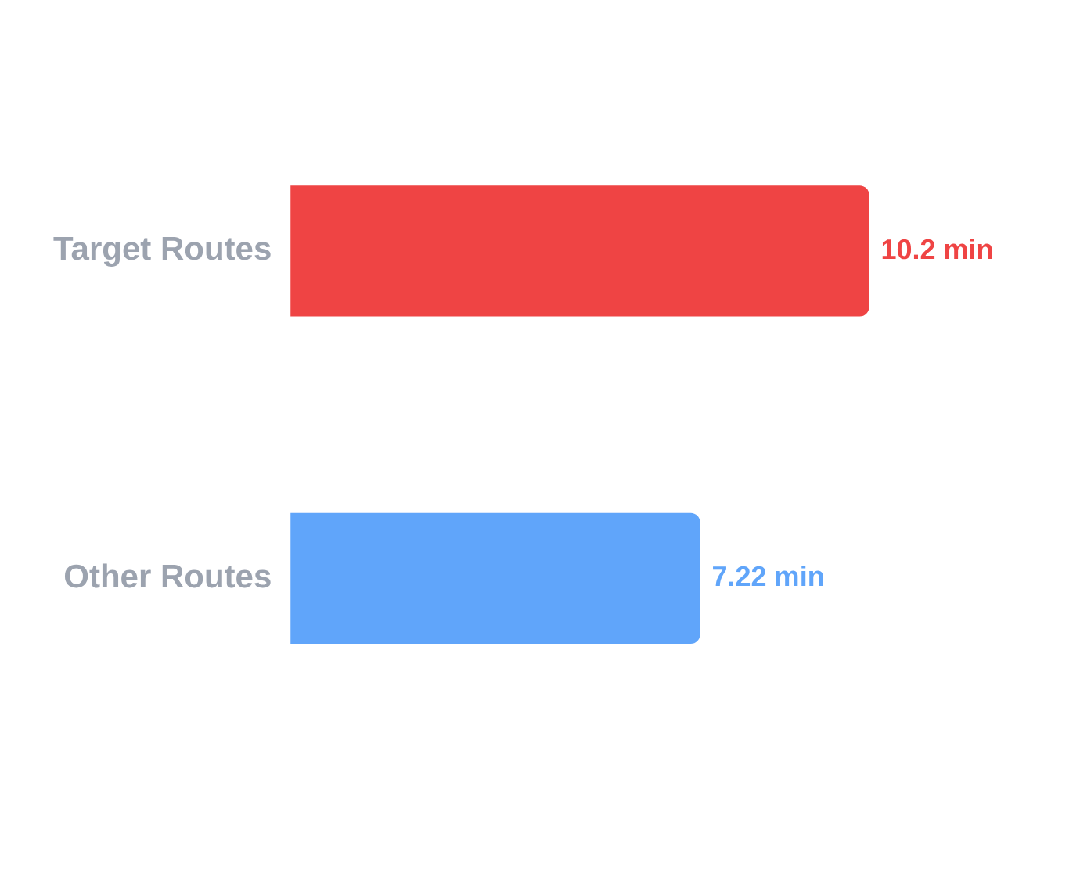
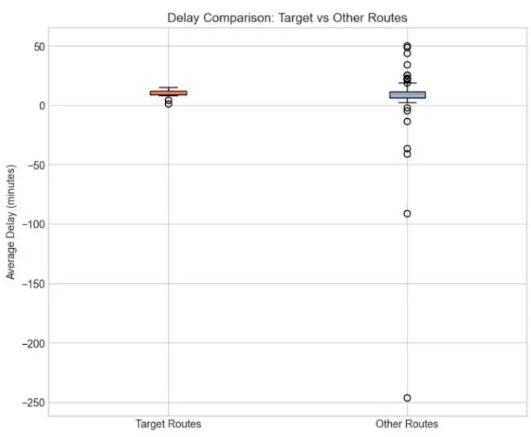










Performance Gaps: Target Routes
Analyzing service disparities for equity-priority routes serving underserved communities.
DELAY DISTRIBUTION ANALYSIS
DELAY DISPARITY
Mean Delay Comparison (Minutes)
+41%
Higher Delay
Target routes experience significantly higher average delays compared to citywide averages.
TARGET OTP
OTHER OTP
25.8%
32.3%
On-Time Performance
On-Time Performance
EQUITY PRIORITY ROUTES
14
15
17
22
23
24
26
28
29
31
33
42
44
45
111
Insight: The clustering of target routes in the lower performance tier creates significant time-poverty for residents in transit-dependent vulnerable neighborhoods.

Slide 7












Service Disparities and Reliability Distribution
Significant variation exists in service quality, where the bottom 10% of routes achieve less than 20% on-time performance, often correlated with high-ridership capacity constraints.
Performance Range
Service Score Distribution
Top 10% Routes:
45%+
Bottom 10% Routes:
<20%
On-time performance rates
Service Variation Metrics
Standard Deviation
Target vs Other Routes Comparison
15.2 points
Routes Analyzed
210 routes
Performance Tiers
Distinct clusters
Key Insight: Capacity-Performance Correlation
Routes with higher ridership tend to experience more delays due to capacity constraints, creating a feedback loop where popular routes become less reliable over time.

Slide 8



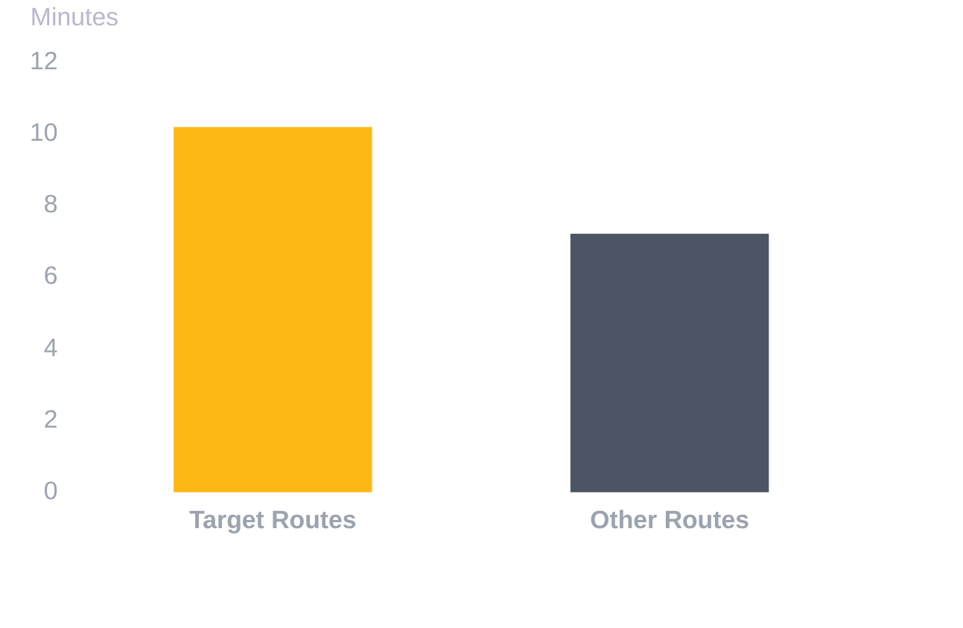
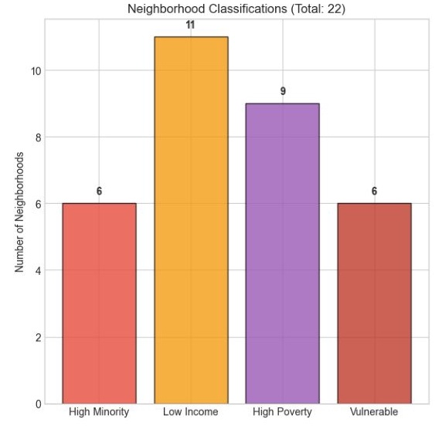









DEMOGRAPHIC IMPACT AND EQUITY FINDINGS
Correlation analysis reveals no systematic bias against minority populations overall; however, specific target routes identified for equity priority continue to underperform significantly.
CORRELATION ANALYSIS
PERFORMANCE DISPARITY
Mean Delay vs Minority %
Mean Delay: Target Routes vs. Other Routes
-0.007 (NS)
NEIGHBORHOOD PROFILES
Mean Delay vs Hispanic %
-0.332 (Sig)
*NS: Not Significant. Sig: Statistically significant (p < 0.05).
VULNERABLE NEIGHBORHOODS
HIGH MINORITY + LOW INCOME AREAS (6 TOTAL):
Dorchester
East Boston
Hyde Park
Mattapan
Breakdown of neighborhoods by Minority, Income, and Poverty classifications.
Mission Hill
Roxbury
+41% Longer Delays
SERVICE GAP
Conclusion: While no systemic demographic bias exists citywide, the Target Routes (which serve high-minority areas) underperform due to external factors like route length and traffic, creating localized equity burdens.

Slide 9












Analytical Limitations
Understanding the constraints and scope of the findings
DATA CONSTRAINTS
ANALYTICAL SCOPE
Missing Historical Data
CAUSALITY VS. CORRELATION
Bus Arrival/Departure records for 2018-2019 are unavailable on the MBTA portal, limiting pre-pandemic delay analysis.
Observed relationships between demographics and service quality may be driven by confounding factors like route length or infrastructure.
Sampling Methodology
Quick analysis utilized a 5% sample of the full dataset for computational efficiency; full analysis is recommended for production.
TEMPORAL SCOPE
Post-pandemic data (2020-2024) may not yet reflect "normal" operations due to ongoing recovery and service adjustments.
Geographic Approximation
AGGREGATION VARIANCE
Stop-to-neighborhood mapping uses coordinate-based bounding boxes rather than precise polygon boundaries.
Demographic profiles are averaged across neighborhoods served, which potentially masks significant within-route variations.
MBTA Open Data Portal Analysis 2025
Constraints were mitigated where possible through cross-verification with Ridership data (2016-2024) which remained complete.

Slide 10







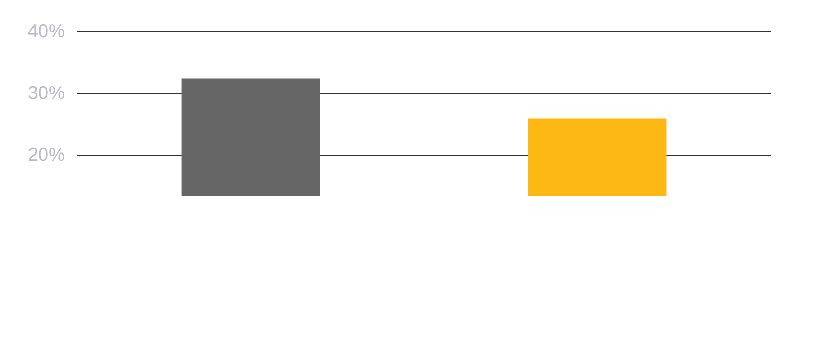




Conclusions & Strategic Recommendations
10
Final Synthesis and Policy Roadmap for MBTA Bus Equity
KEY CONCLUSIONS
STRATEGIC ROADMAP
Ridership Recovery: Post-pandemic levels remain 32.8% below 2016-2019 averages.
Prioritize Target Routes
Service Quality: Only 31.7% OTP citywide, indicating systemic reliability challenges.
Focus bus lanes, signal priority, and infrastructure on the 15 high-delay equity routes identified.
Equity Gap: Target routes experience 41% higher delays (10.2 min avg) than standard routes.
Peak Hour Interventions
Deploy additional standby resources during evening rush (4-7 PM) when delays reach peak levels.
ON-TIME PERFORMANCE (%) GAP
Establish Equity Metrics
Implement ongoing tracking of service quality by neighborhood demographics to ensure transparency.
BOSTON BUS EQUITY ANALYSIS | SPRING 2025
Restore Historical Data
CS506 DATA SCIENCE TOOLS AND APPLICATIONS
Work with MBTA to restore 2018-2019 arrival data for comprehensive pre/post pandemic trend analysis.

